Slide 1


GOING GLOBAL
@THETlinks @NHS_HealthEdEng
#NHSGoingGlobal

Slide 2


Slide 3
An Introduction to Health Education England
HEE is the NHS workforce body
Core Functions
Commissioning and delivering education/ training, managed through a national network of training providers and NHS education experts
Managing supply and demand for the NHS workforce, working closely with NHS Trusts to develop a skilled, capable workforce fit for the future
Workforce planning and strategy for the future
Commissioning and delivering education/ training, managed through a national network of training providers and NHS education experts
Managing supply and demand for the NHS workforce, working closely with NHS Trusts to develop a skilled, capable workforce fit for the future
Workforce planning and strategy for the future

Slide 4



Global Challenges
Urgent sustained coordinated action
Global movement of healthcare professionals
Global health workforce gap to reach 18m by 2030
Staff need increasingly adaptable skills
Notes:
Global health workforce gap to reach 18m by 2030
Global movement of healthcare professionals between countries
Staff need increasingly adaptable skills to provide whole person care, focus on primary and community, health promotion and prevention
We need urgent sustained coordinated action to build a more robust global health workforce

Slide 5

Global Engagement Priorities
Utilise NHS expertise to support health system strengthening globally
Embed global learning into education and training through overseas placements for NHS staff
Address critical shortages in the NHS through educational NHS placements for overseas staff

Slide 6

Overseas Placements for NHS Staff
Embedding global learning into education and training through overseas placements for NHS staff
Developing leadership and clinical skills and support recruitment and retention within the NHS
Clinical placements for trainee doctors in South Africa and Quality Improvement placements for clinical and non-clinical staff across six countries
Signposting NHS staff to opportunities and toolkits to support NHS trusts to offer overseas experience to improve recruitment, retention and staff satisfaction

Slide 7
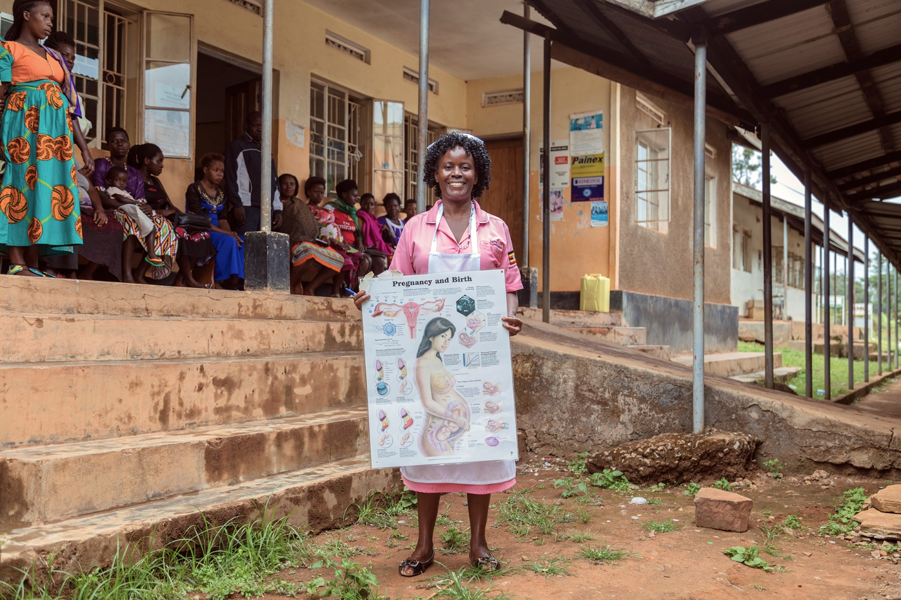
One billion people will never see a qualified health worker.
Notes:
For over 30 years, THET has been working to change this, supporting health workers both in the UK and overseas, improving patient care through targeted training programmes.

Slide 8

For over 30 years we have been working to change this…
We train, support and educate health workers in Africa and Asia, working in partnership with organisations and volunteers from across the UK.
Founded in 1988 by Professor Sir Eldryd Parry, we are the only UK charity with this focus.
Since 2011, we have been the managing agent of the UK’s largest Health Partnership Programme.

Slide 9
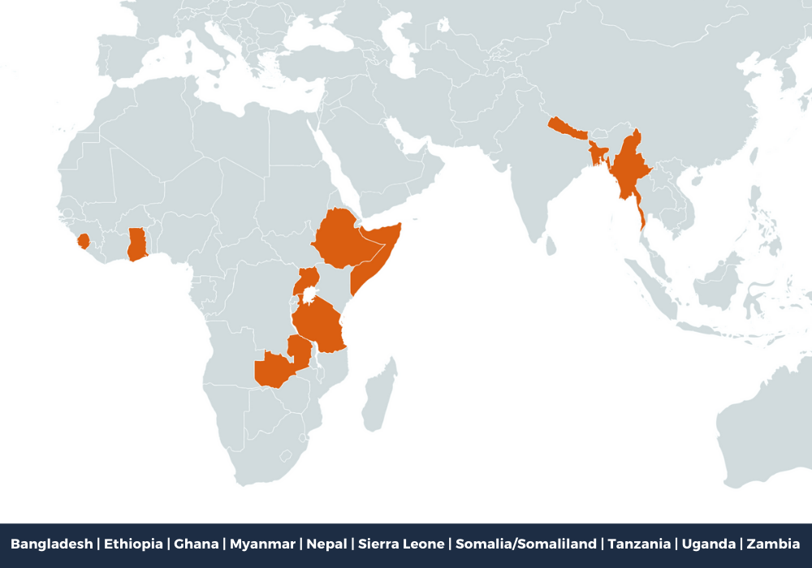
Country Presence

Slide 10

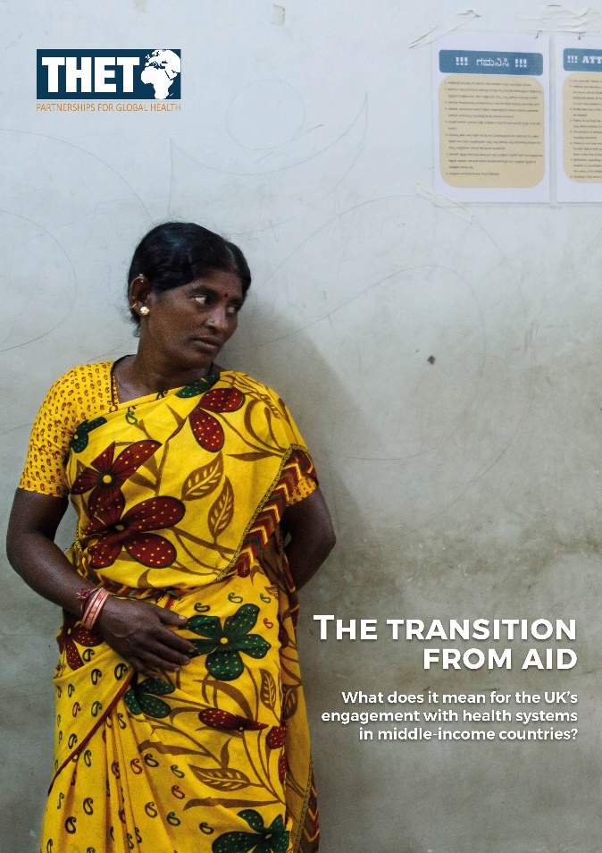


Policy Reports and Discussion Papers
Support for Volunteers

Slide 11
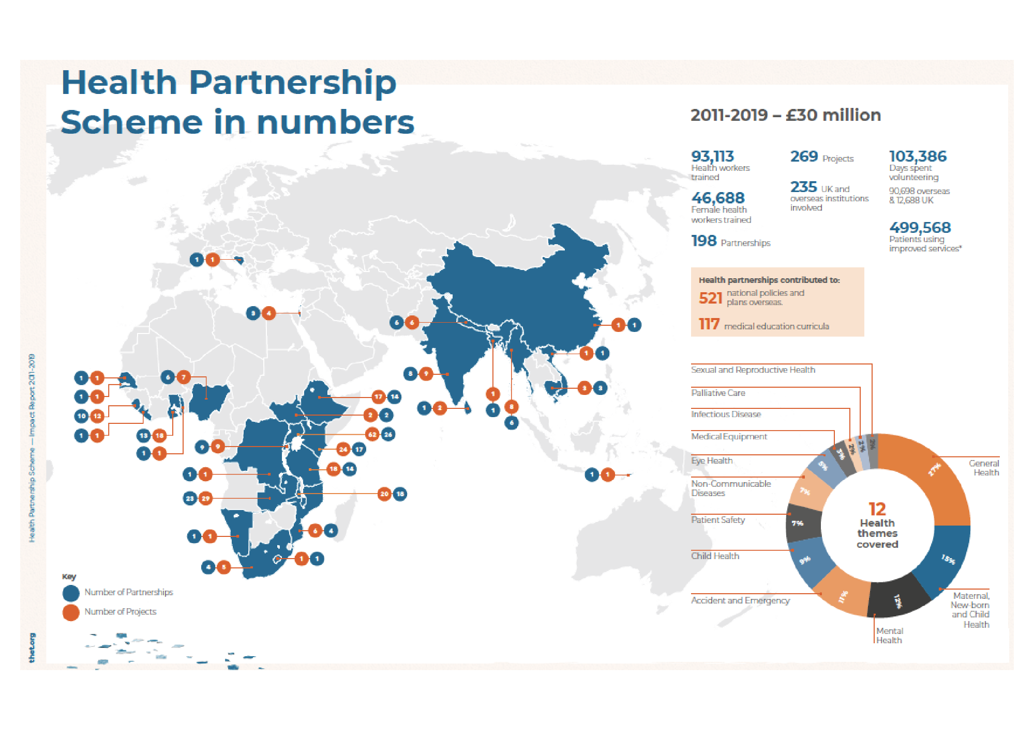

Slide 12
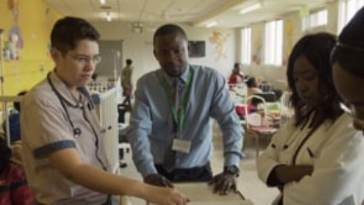

Slide 14
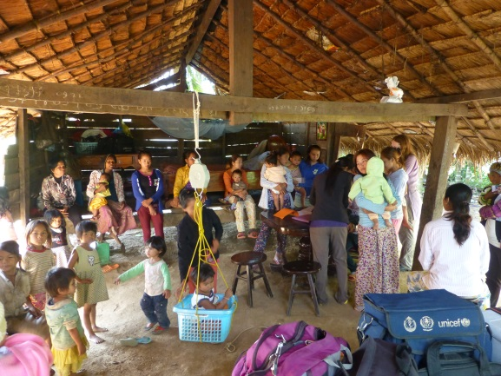
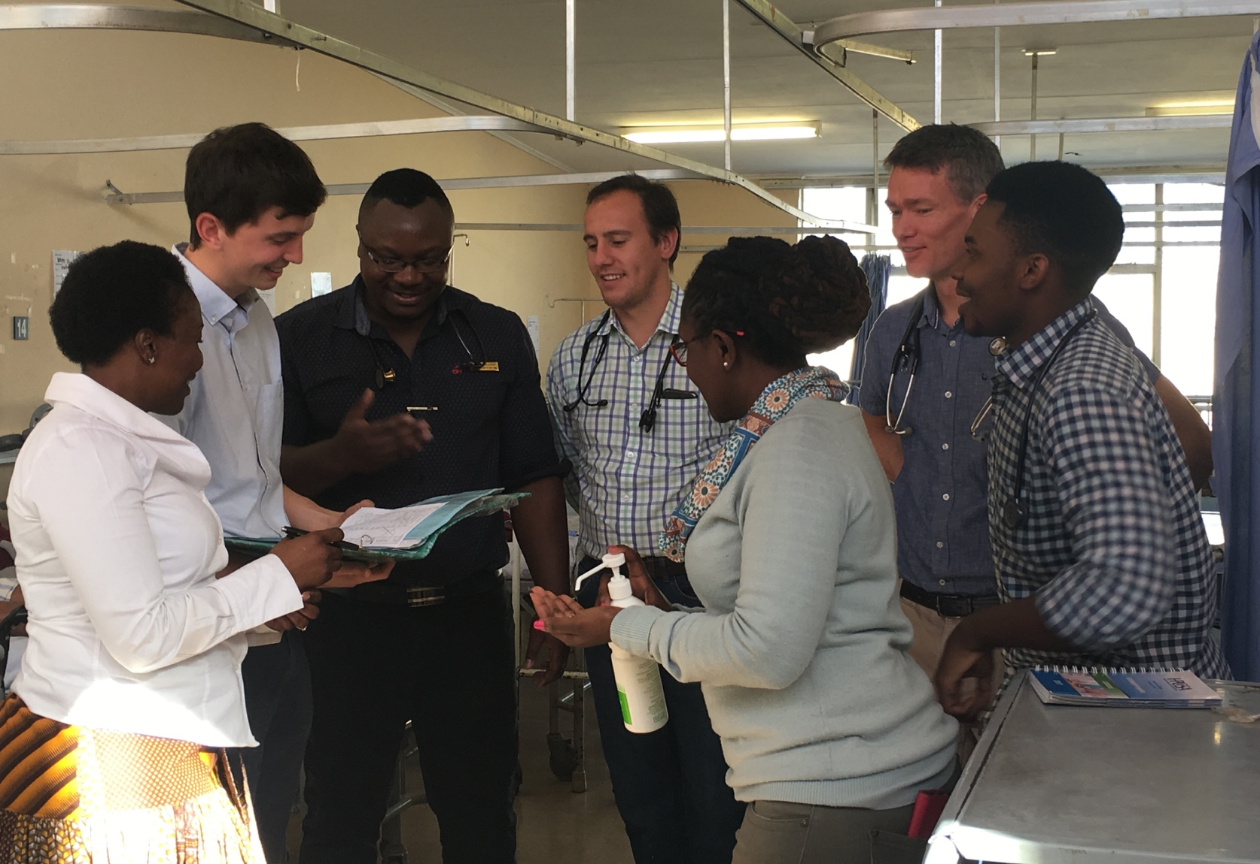
How to capture your learning
Fleur Kitsell – IGH Programme Lead
HEE Global Engagement
Fleur.Kitsell@hee.nhs.uk

Slide 15
‘In our Mutual Interest’ (2016)
“This report points to the huge benefit that can be derived by both the UK and our partners and governments overseas when the right balance is struck between our own organisational and national interest, and the interest of people living in some of the world’s poorest countries
Not only is this good for countries overseas, who deserve our support to overcome the poverty they face, it is also good for the UK. Those who travel overseas, bring home fresh ideas about leadership, innovation and service-delivery, which directly benefit our work in the UK. I know this from my own experience.”
(Dame Sally Davies, 2016)
https://www.thet.org/resources/thet-in-our-mutual-interest/

Slide 16
Recognising your Learning and
Development

Slide 17
Types of Development
(Based on ideas of Nick Petrie,
Center for Creative Leadership, 2014/2015 https://www.ccl.org/wp-content/uploads/2015/04/VerticalLeadersPart1.pdf)
Horizontal Development:
  refers to the adding of more knowledge, skills, and competencies. It is about what you know
Vertical Development:
  refers to advancement in a person’s thinking capability. The outcome of vertical stage development is the ability to think in more complex, systemic, strategic, and interdependent ways.

Slide 18

Horizontal Development
New content, such as: how to develop staff, how to communicate effectively, a new clinical skill, how to read music, cook a meal
New tools, skills, and models

Slide 19
Vertical Development
Heat Experiences
Elevated Sense- making
Colliding Perspectives
The Who
Different perspectives
Curious
The What
Out of comfort zone
Open your mind
The How
Coach/mentor, to make sense
Reflection
Nick Petrie (2015) Center for Creative Leadership
https://www.ccl.org/wp-content/uploads/2015/04/verticalLeadersPart2.pdf

Slide 20
Recording your
Learning and
Development

Slide 21


HEE
Toolkit
NHS Healthcare Leadership Model (2013)

Slide 22
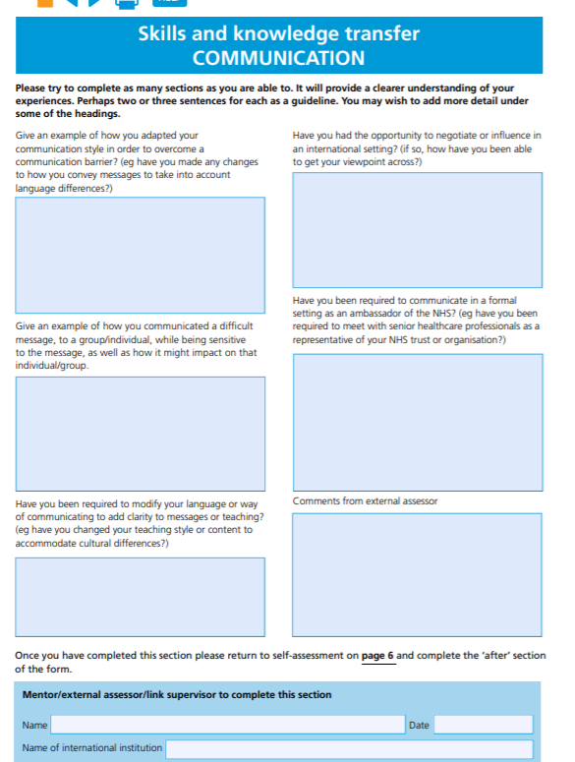

Slide 23
HEE Toolkit – Page 7 https://www.hee.nhs.uk/sites/default/files/documents/2312-HEE%20Toolkit%20for%20evidence%20Interactive%20v4.pdf
Give an example of how you adapted your communication style in order to overcome a communication barrier? (e.g. have you made any changes to how you convey messages to take into account language differences?)
Have you been required to modify your language or way of communicating to add clarity to messages or teaching? (e.g. have you changed your teaching style or content to accommodate cultural differences?)

Slide 24
NHS Healthcare
Leadership Model (2013) https://www.leadershipacademy.nhs.uk/wp-content/uploads/2014/10/NHSLeadership-LeadershipModel-colour.pdf
Inspiring Shared Purpose
Leading with Care
Evaluating information
Connecting our Service
Sharing the Vision
Engaging the Team
Holding to account
Developing Capability
Influencing for results

Slide 25
NHS Healthcare Leadership Model
Look at the following domains
  ‘Inspiring Shared Purpose’ on page 5;
  ‘Evaluating Information’ on page 7;
Ask yourself the questions it asks
Think about your current role and relate the questions posed to your role – if you were to answer ‘Yes’ to any question, what evidence do you have to justify your answer?

Slide 26


Slide 27
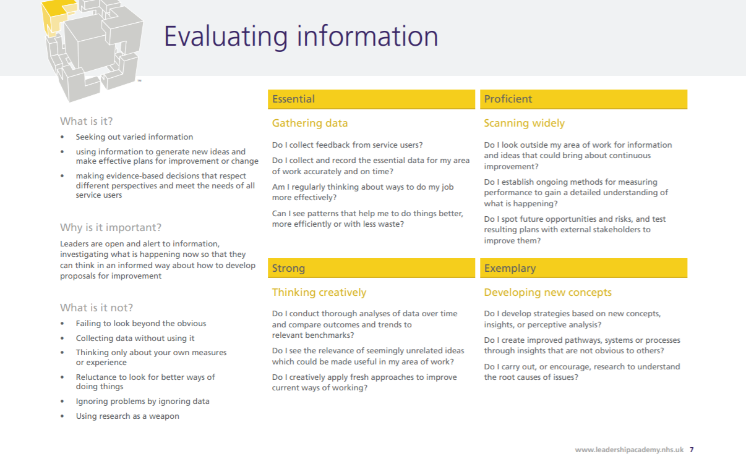

Slide 28
Learning from
Significant Events

Slide 29
Appreciative Inquiry (AI)
Choose a positive experience
Describe the experience (concisely) and why you chose it
  identify who was there
  describe what you did (behaviours)
  describe what others did (behaviours)
On reflection what key things do you think you did that helped to make this such a successful and positive experience that you can consciously use in the future

Slide 31
To access all of the information from today and the resources shared, please visit www.goingglobalday.com and visit our resources page.
THANK YOU!
For more information or enquiries please contact:
Charlotte Ashton, Communications Manager, THET charlotte.Ashton@thet.org

