Slide 1
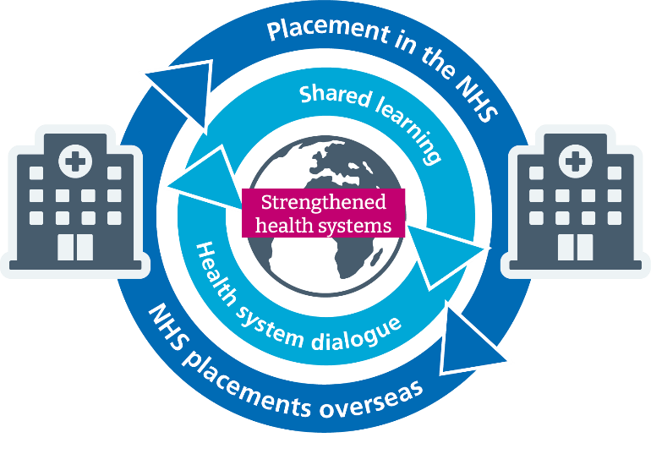
Going Global 13th October
Virtual Volunteering
Dr Fleur Kitsell, Senior Lead Global Placements and Volunteering, Global Health Partnerships, Health Education England
Helen Slattery Project Manager, Global Health Partnerships, Health Education England

Slide 2
Outline of the session
Define what is meant by virtual volunteering
Recognise the benefits the individual by virtual volunteering
Explore an evaluation of a pilot of Health Education England virtual volunteering experience via the Improving Global Health Programme
Tropical Health and Education Trust
An example of a virtual volunteer opportunity –Virtual Doctors
Volunteer experience comparing a physical and virtual experience
Volunteer experience of a virtual experience
How to get involved
Any Questions?

Slide 3
What do we mean by Virtual Volunteering ?
most are a variation on the definition below
“Virtual volunteering refers to volunteer activities completed, in whole or in part, using the Internet and a home, school, tele-center, or work computer or other Internet-connected device, such as a smart phone or personal digital assistant (PDA).^{[1]} Virtual volunteering is also known as online volunteering, remote volunteering or e-volunteering”.
https://en.wikipedia.org/wiki/Virtual_volunteering

Slide 4
HEE Global Strategic Priorities
NHS Individual Development
Education and learning for the NHS workforce
A developmental offer to individual current and future NHS employees to provide professional development, career progression, and support life-long learning
Developing and improving individual members of NHS staff
Attracting more people into globalised NHS careers
Promoting diversity in leadership
NHS System Strengthening
Educational migratory pathways into the NHS
An offer to the population of England and through mutually beneficial partnerships which benefit the NHS organisations and systems, improving quality & transparency of existing programmes.
Increasing the number of overseas staff able to work in the NHS
Improving the ability of those staff to meet patient needs
Reducing differential attainment
Global Health System Strengthening
Global consultancy and knowledge exchange
An offer to the world to facilitate mutual health system strengthening for other health workforces using HEE’s expertise, based on co-creation of solutions
Access to NHS expertise
Promote UK expertise in Health Systems Strengthening
Develop commercial models to drive sustainability
Notes:
We have identified 3 Global Strategic Priorities for consultation. These three elements align with our purpose to improve and develop the workforce and services in England. Working with partners to attract, educate, and train a globalised health workforce – and recognising that directly collaborating with our peers overseas can support the Government’s broader global health objectives as well as benefit the NHS.

Slide 5
Strategic Priority 1:
NHS Individual Development
It is vital that that health workers are adaptable and resilient, able to rapidly adapt to changing working environments and are able to learn new skills as they undertake their career journeys. In order to develop this adaptability, each member of our workforce needs to develop ‘metaskills’ including emotional intelligence, leadership, cultural competence and intelligence, resilience, flexibility, adaptability and communication.
There is significant and mounting evidence that exposure to global clinical environments increases the speed and depth of metacognitive learning. In addition, multiple studies have shown that front-line staff value global experiences including global placement and volunteerism, cross border peer to peer relationships and global educational activity.
Despite evidence that facilitating global engagement by front line clinicians improves recruitment, retention, job satisfaction, cultural intelligence, leadership development and productivity, opportunities are often profession-dependent and limited in scope and scale.
HEE is committed to increasing the quantity and quality of these opportunities for the NHS workforce.
Education and learning for the NHS workforce
Notes:
An offer to the individual for global learning opportunities, through fellowships, volunteering and peer to peer learning. Individuals and the NHS benefit from the development opportunity, whilst also supporting a host organisation.
We do recognise that there are gaps at the moment in the system in terms of a coordinated approach and equity of offer to the front line.
We recognise that learning in a global context does not automatically mean a placement in a low middle income country, but can also involve armchair volunteerism, international volunteerism, form parts of training courses, and development of peer to peer learning to name a few. All of these opportunities promote the development of metaskills within our workforce.

Slide 6
An example:- Health Education England virtual volunteering opportunity - Gulu Diagnostic Imaging Project
A pilot project has been developed to support capacity building within imaging services in two hospitals in Gulu, a city in the north of Uganda. The project will use a combination of long-term volunteers, short-term volunteers delivering teaching and training packages and virtual volunteers supporting online education and mentoring
Virtual volunteer activities:-
‘Introduction to Radiology’ 8-week course for 3rd year medical students , content design and delivery ,to contribute to a resource bank for 3rd year medical students ,volunteer facilitated discussions 45minutes once per week
Mentoring of medical students once per fortnight , 45 minutes
Development of the Bachelor of Science (BSc) Medical Radiography (BMR) Programme.
CPD pre reading material and “live” volunteer facilitated discussions for hospital staff

Slide 7
Useful links
https://global-learning-opportunities.hee.nhs.uk/

Slide 8
Evaluation Virtual IGH Fellowships
The IGH Fellowship Programme recruits and awards NHS staff from all clinical and managerial backgrounds an IGH Global Fellowship – these Fellows work collaboratively on a project with an overseas partner team, who determine the focus and scope of the project. The IGH Fellows do not provide direct patient care.
Due to prolonged international travel restrictions resulting from the COVID-19 pandemic the IGH programme team (with seven of the existing IGH Programme overseas’ partners) developed a pilot model of part-time remote/virtual Fellowships. A pilot cohort of 13 Fellows began these 6-month Fellowships in February 2021.

Slide 9
Evaluation Participants
Fellows: 13 who participated; 10 of whom responded.
Mentors: 13 who participated; 7 of whom responded
Partnership Link-Leads (PLLs): 7 who participated; 5 of whom responded

Slide 10
Key Findings
All 10 Fellows recommended a virtual Fellowship
Most respondents were pleasantly surprised at how effective this model of Fellowship was, for all parties
The reduced time available for Fellows to participate in the Fellowship impacted on what was achieved and learned
Fellows reported improvements in their digital skills, and that this would be valuable to their work in the NHS
Fellows identified several advantages to working virtually, this included personal circumstances, as well as for the work they carried out with the overseas’ team
Certain types of project work appeared more suitable for virtual working e.g. scoping work, education, review, evaluation, analysis, report-writing etc. Implementation work was more challenging

Slide 11
Video – LInda Orazulume
Linda Orazulume THET Global Day.mp4

